Slide 1
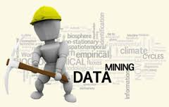
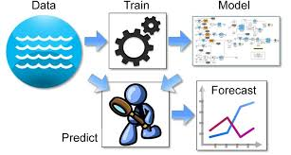
An Introduction to
Predictive Analytics/Data Mining

Slide 2
Predictive Analytics
Not new, the algorithms have existed for many years – has roots in classical statistics, machine learning, and artificial intelligence
The automated process of finding relationships and patterns in stored data
Also known as data mining
It is different from the use of SQL queries and OLAP

Slide 3
Queries and Reporting | Business Intelligence | Predictive Analytics
Extraction of data and providing detail and summary reports | Analysis and trends | Discovery of hidden patterns, information, and forecasts of the future
Information | Analysis | Insight, knowledge and prediction
Who purchased the product in the last 2 quarters? | What is the average income of the buyers per quarter per district? | Which customers are likely to buy similar products in the future?

Slide 4
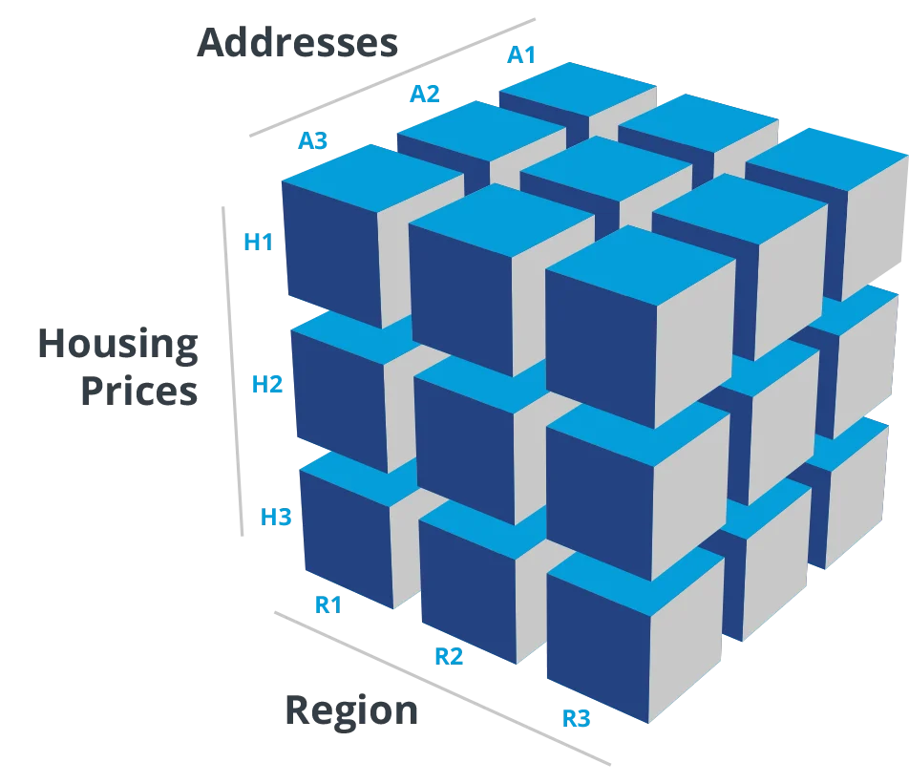
Online Analytical Processing
(OLAP)

Slide 5
Online analytical processing (OLAP) is a category of software technology that enables analysts, managers, and executives to gain insight into data through fast, consistent, interactive access to a wide variety of possible views of information that has been transformed from raw data to reflect the real dimensionality of the enterprise as understood by the user.
“Slicing and dicing” data

Slide 6
A Typical Question
How many cases of pretzels were sold in Pittsburgh on promotion last week?
This is a multidimensional question

Slide 7
Example: OLAP Usage of an Automobile Marketer
The Story
An automobile marketer wants to improve business activity. Therefore he wants to view sales figures from different perspectives.
The Data Needs
Sales by model
Sales by dealership
Sales by color
Sales over time
etc.
A Question
What is the trend in sales volumes over a period of time for a specific model and color across a specific group of dealerships ?

Slide 8
Example: The Multidimensional Database Used
Sales Volumes
Van
MOD E L
Coupe
Smith
Sedan
Clyde
Miller
Blue
Red
White
DEALERSHIP
COLOR

Slide 9
OLAP Features: “Dicing“ - Ranging of Data
Choosing a range out of each dimension:
Color: Blue and White
Model: Coupe only
Dealership: Clyde only
Sales Volumes
Van
Coupe
Clyde
MOD E L
Coupe
Blue
White
Smith
Sedan
Clyde
“Diced“ Data
Miller
Blue
Red
White
DEALERSHIP
COLOR

Slide 10

OLAP Features: “Slicing“ - Rotation of Data
Different Users will require different views (cross tables or “slices“) of the multidimensional cube – OLAP allows easy rotation of data
View of the Product Manager
View of the Account Manager
Sales Volumes
Rotate the data cube by 90°
Sales Volumes
Van
Van
MOD E L
MOD E L
Coupe
Coupe
Sedan
Sedan
Blue
Red
White
Miller
Smith
Clyde
COLOR
DEALERSHIP

Slide 11
OLAP Features: Drill-Down and Roll-Up
Data can be disaggregated and aggregated along a dimension according to their natural hierarchy
Roll-Up
Sales Volumes by Organization Dimension
- three level hierarchy -
State
Georgia
Region
Atlanta
Athens
Dealership
Miller
Smith
Clyde
Lucas
Gleason
Drill-Down

Slide 12
OLAP Versus Data Mining
With OLAP, the user creates the hypotheses to be explored
With data mining, the algorithms create hypotheses (to be further explored)
OLAP and data mining are complimentary; for example, OLAP can be used to better understand the data prior to mining, or to further analyze findings from data mining
“Diapers and beer” is the classic example of an interesting finding from data mining

Slide 13
Predictive Analytics Is
Motivated by business need, large amounts of available data, and humans limited cognitive processing abilities
Enabled by data warehouses, parallel processing, and advanced algorithms
Especially important to customer relationship management (CRM) – market segmentation analysis, lifetime customer value, customer churn

Slide 14

Different Approaches to Data Mining
Artificial Intelligence
Statistics
Machine Learning

Slide 15






Various Kinds of Data Mining
Data Mining
Discovering meaningful patterns from large data sets using pattern recognition technologies
Web Mining
Data Mining focused on the analysis of Web usage, structure & content
Text Mining
Using natural language processing
& data mining to discover patterns
in a collection of “documents
Image/Video Mining
Using image/video processing & analysis to uncover patterns in collections of images/videos

Slide 16
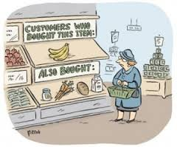
Common Types of Information from Predictive Analytics
Associations -- identifies occurrences that are linked to a single event (e.g., market basket analysis)

Slide 17

Common Types of Information from Predictive Analytics
Sequences -- identifies events that are linked over time (e.g., appliance sales follow new home sales)

Slide 18

Common Types of Information from Predictive Analytics
Classification -- recognizes patterns that describe the group to which an item belongs (e.g., customer who is likely to leave)

Slide 19

Common Types of Information from Predictive Analytics
Clustering -- discovers different groupings within the data (e.g., market segmentation)

Slide 20
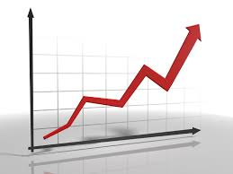
Common Types of Information from Predictive Analytics
Forecasting -- estimates future values (e.g., customer lifetime value)

Slide 21
Commonly Used Predictive Analytics Methods – A Mixture of Statistical, Machine Learning, and AI Techniques
Decision trees
Classification and regression analysis
K-means
Nearest neighbor method
Neural networks
Deep learning

Slide 22
Types of Predictive Models
Supervised
Unsupervised
The categories for the output variable are defined in advance – classification information
Example: What are the variables that classify Trump and Clinton voters
Answer: age, college educated, etc.
The categories for the output variable are determined by the algorithm
Example: What are the categories of users of high-octane gasoline
Answer: Owners of upscale and muscle cars

Slide 23

Predictive Analytics Software
Programming Languages
Analytical Workbenches
SQL
R
Python
SAS Enterprise Miner
IBM SPSS Modeler
Rapid Miner (open source)
KNIME (open source)

Slide 24

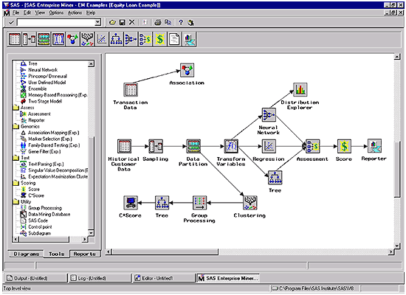
Cobbler’s Workbench
Analytical Workbench

Slide 25
There Are Differences Between BI and Data Science Platforms
BI Platforms
Data Science Platforms
Used for descriptive analytics
Reporting, visualization, and dashboards
Used by business analysts, managers, and decision-makers
Provide actionable insights and key performance indicators (KPIs) through historical analysis
Used for predictive analytics
Building, training, and deploying machine learning models
Used by data scientists, machine learning engineers, and statisticians
Generate predictive insights, automated decision-making, and data-driven recommendations

Slide 26
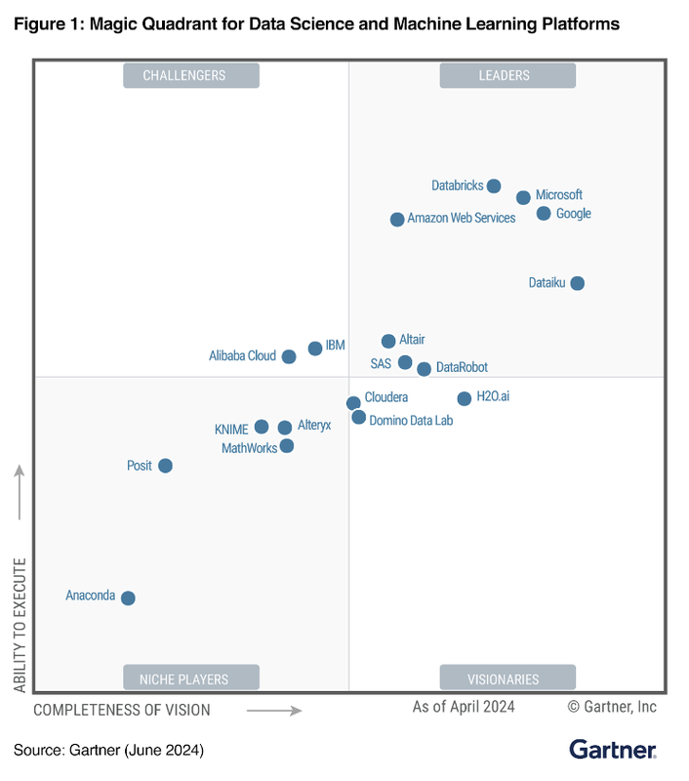

Slide 27



Analytics to Fight Tax Fraud

Slide 28

The Challenge
Identity theft and fraudulent returns
Catch the thieves but don’t audit correct returns

Slide 29
Predictive Tax Audit Methods
Rules-based methods (e.g., If charitable deductions > X, then Y)
Detecting a stair-stepping pattern by a filer or preparer (e.g., a refund return that keeps going up every year)
Anomaly detection (e.g., an itemized deduction that is out of line with an income peer group or geographic neighborhood)
Statistical scoring of returns (e.g., a DIF score is calculated for every return)

Slide 30

Building Predictive Models
Profile the data
Establish expectations for the model
Create development/training and testing/validation datasets
Develop alternative models from the training/testing data using different algorithms
Assess the predictive power of the alternative models using the testing/validation data
Select and implement the model that best meets the expectations for the model
Keep the models up-to-date

Slide 31
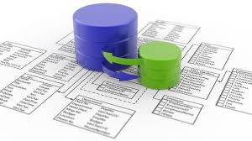
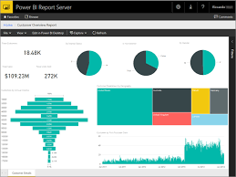
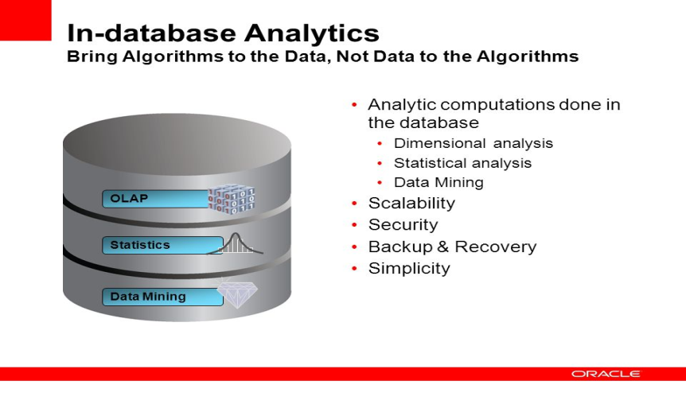
Technology Enablers of Predictive Analytics

Slide 32
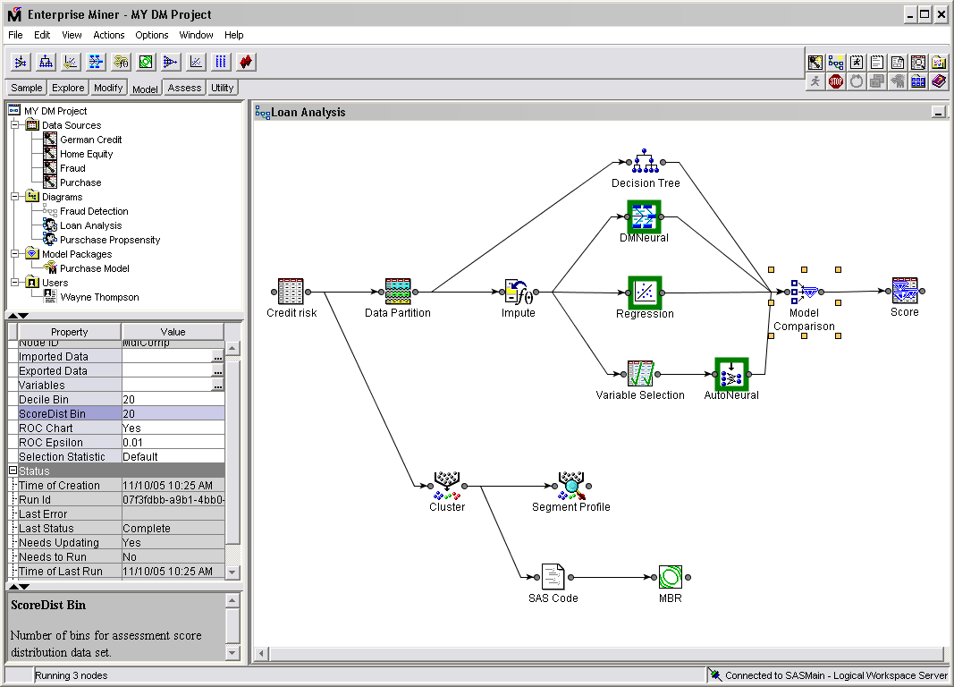
#1 - Analytical workbenches
Graphical
Integrated
Automated
Notes:
The first big breakthrough is the creation of analytical workbenches like the one pictured here from SAS Institute. The workbenches are graphical so you don’t need to be a programmer to create a sophisticated model. All you do is point, click, drag, and drop. Second, the workbenches are integrated. Remember the six-step process I showed earlier? The workbenches now support all six steps in the process, from helping you define and schedule your project to managing models in a group environment.
Perhaps, most importantly, they are automated. That means they will automatically apply multiple algorithms to your dataset and problem and score the accuracy of each model so you can select the best one. You hit a button and it does all the work that used to take a Phd statistician days, if not weeks.
Finally, the workbenches use a client/server architecture so analysts can store models and data on a robust server rather than downloading and processing all data on a desktop or workstation. A client/server architecture also makes it easy to capture and store source data from multiple back-end statisticians.
The bottom line is that the new generation of analytical workbenches makes it possible for non-statisticians and non-programmers to create elegant analytical models.

Slide 33
#2 - New database functionality
Analytical functions
  Profile data
  Transform, reformat, or derive columns
  Restructure tables, create data partitions
  Generate samples
  Apply various algorithms
  Visualize model results
  Score models
  Store results
Notes:
The next major breakthrough has come from database vendors who have added a slew of new functionality to support most of the steps involved in creating an analytical model. For instance, this is a list of analytical functions supported by one database vendor:
Profile data
Transform, reformat, or derive columns.
Restructure tables, create data partitions
Generate samples
Reduce data size through
Apply native analytical algorithms
Visualize model results
Score models
Store results
Basically, you can explore the data, prepare the data, create the model, and score records all in the database. You never have to move the data from one machine to another again!

Slide 34
#3 - Leverage the data warehouse
It is estimated that data preparation requires 70-80 percent of the time spent on data mining
Saves time
  Sourcing data from multiple locations
  Cleaning, transforming, and formatting data
Don’t have to move data
  To prepare data, create models, score models
  Avoids clogging networks and slowing queries
Take advantage of in-database mining
But data mining does not require a data warehouse
Notes:
Besides analytical database functions, data warehouses are a big boon to analytical modelers. That’s because a data warehouse already collects data from multiple sources, and cleans, transforms, and standardizes it. If your data warehouse contains most of the data you need to create analytical models, this greatly reduces the amount of work you need to do in steps 2 and 3 of the analytical modeling process! And if the data warehouse doesn’t contain that data, well, that’s what it’s designed to do: go out and collect it and integrate it.
And again, if you’re underlying data warehouse database supports analytical functions mentioned in the previous slide, you don’t have to move data to do additional transforms, which avoids clogging networks and slowing query performance.

Slide 35
Analytic Data Marts/Appliances
Operational
System
Operational
System
Operational
System
Operational
System
Operational
System
Data Warehouse
(RDBMS)
Other Data Marts
Analytic Data Mart
Other Data Marts
Other Data Marts
May be an appliance
Notes:
The best way to leverage the data warehousing environment for predictive analytics applications is to create an analytical data mart from the data warehouse. Since analytical modelers often perform heavy duty queries to flatten, aggregate, format, and score data, you need to give them their own analytical sandbox in which to play so their processing doesn’t interfere with other queries. Of course, if you are a Teradata customer, this analytical data mart is most likely a set of logical tables within the central data warehouse.

Slide 36
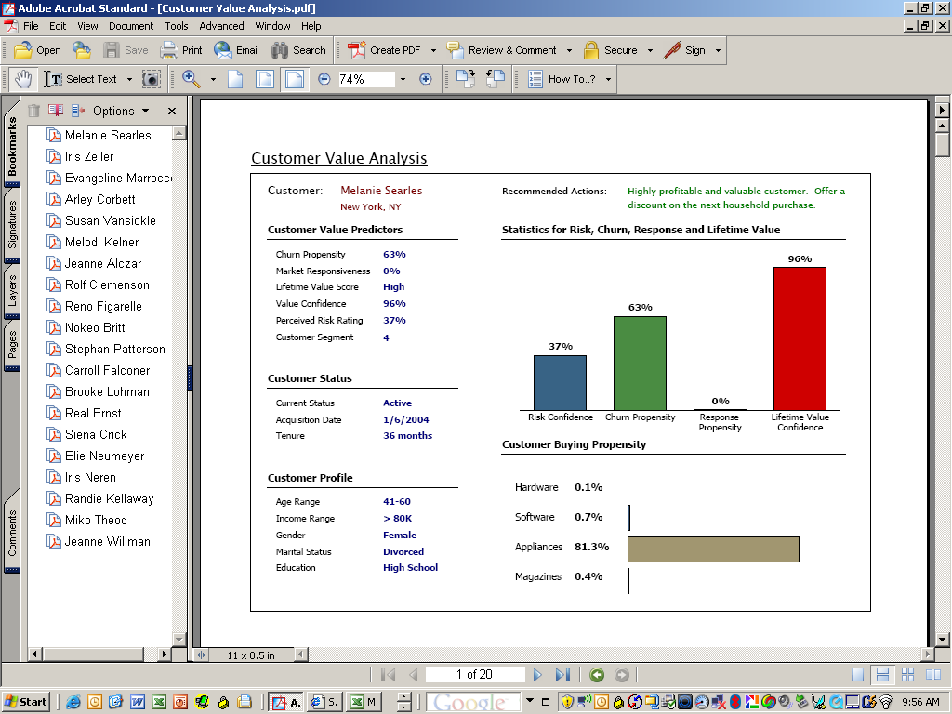
#4 – Deployment via Reports and Dashboards
Notes:
For instance, here is a PDF report – which is hard to read, I apologize for that – that embeds models to calculate customer value and churn for each individual customer and provides recommended actions to the salesperson whom this report is geared to.

Slide 37
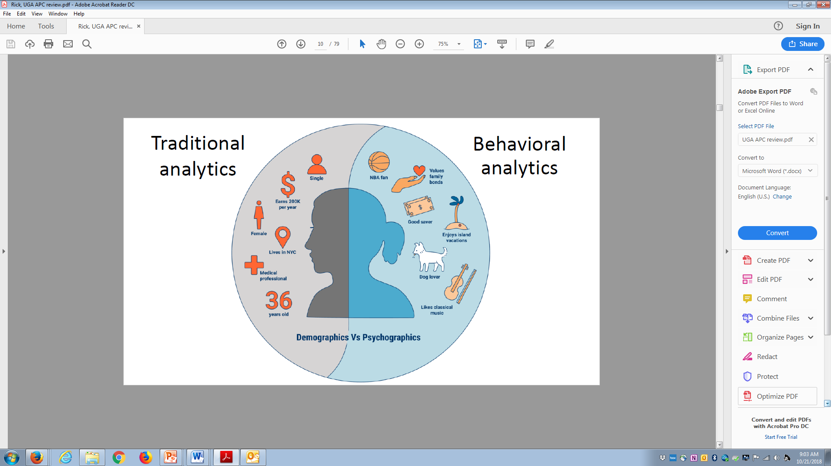
#5 – New kinds of analytics

